Slide 1
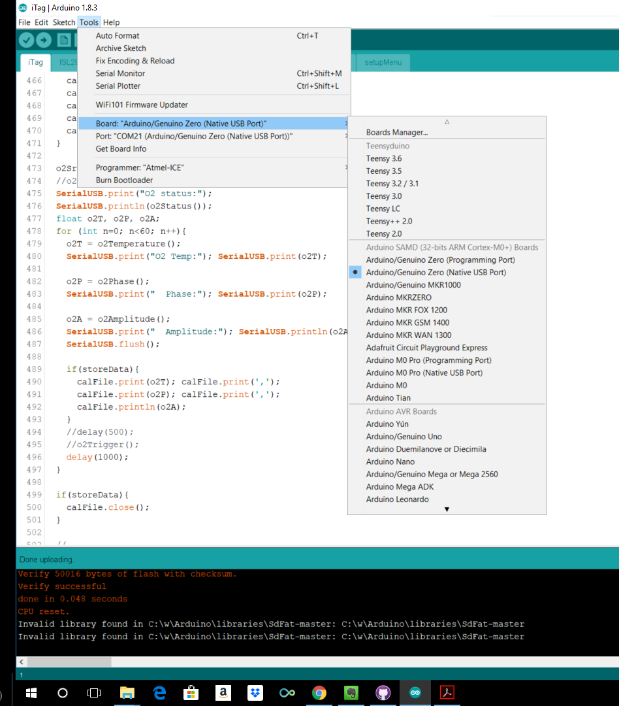
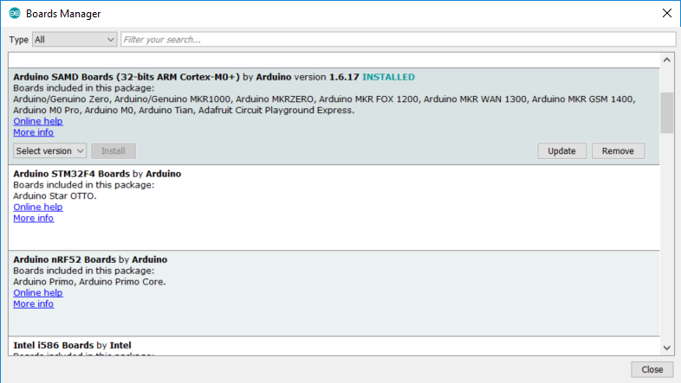
Setting up Arduino IDE to use with iTag for testing sensors
Install Arduino
Tools Menu: Board.
Select Arduino/Genuino Zero (Native USB Port)
If that is not a choice, go to top of list and open Boards Manager, and install Arduino SAMD Boards (32-bits ARM Cortex-M0+) by Arduino
iTag Board
Plug in battery
Plug in USB
It should connect to USB
From Arduino Tools menu, select Port and see if you see a COM port with the Arduino/Genuino Zero, and select it
Serial Monitor
Open Serial monitor from Arduino Tools menu
Type a 9 in the box at the top and press Enter to start the test sequence. Once the test sequence is over, you can remove the microSD card to open the CSV file. You can run multiple tests in a row by pressing 9. They will be appended to the same CSV.

Slide 2
